Slide 1
This
is Bob.
(Cookeville, TN resident)

Slide 2


Value Proposition
No single employer, agency, or institution can move the workforce needle alone. The Upper Cumberland already has the relationships and the tools to act together.
Collaboration is our differentiator.

Slide 3
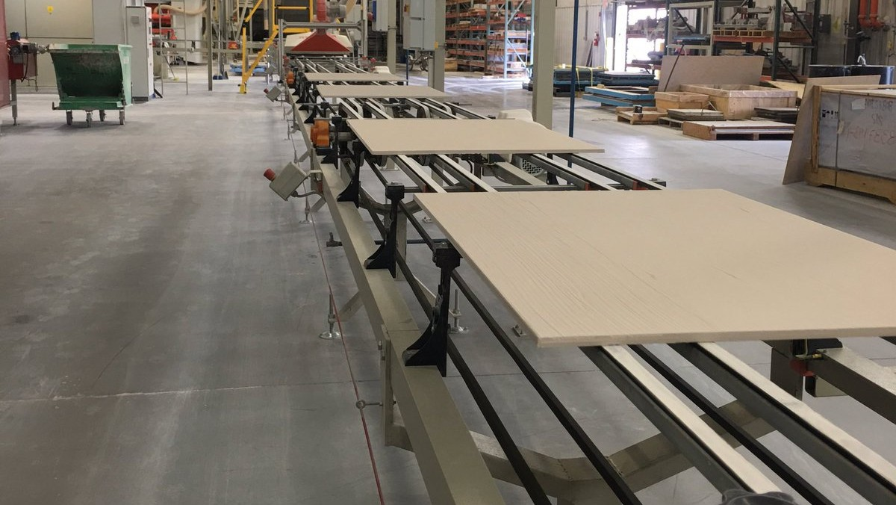




Identified Cluster
Advanced Manufacturing
It is one of the region's largest and most diverse sectors, spanning clay and ceramics, plastics, wood products, and automotive.
Persistent turnover creates a clear, measurable problem we can solve together.
Employers are ready for partnership, which makes a pilot realistic.
Source: TNECD; FirstHR / BLS JOLTS, 2025; The Resource Company, 2025; Deloitte, via Achievers, 2025; The Manufacturing Institute & Deloitte, 2024.

Slide 4

Strategic priority: Build Empower UC 2.0 as a cluster-based workforce participation system that helps residents enter, stay, and advance in jobs connected to resource-based advanced manufacturing and logistics.
Collaboration is a documented regional strength. Our partners are already aligned and at the table.
A proven toolkit already exists and can be customized for a cluster: career pathway app, healthcare bootcamp, executive functioning training.
Modern tools and AI let us enhance and scale these resources cost-effectively. Advanced manufacturing's scale and turnover make it the highest-leverage place to prove the model. Success will be measured on employee retention.
Source: Empower UC, 2026; TNECD; NAM, 2024; Deloitte & The Manufacturing Institute, 2024; NAM, 2025.

Slide 5
90-Day Next Step
30 Convene regional employers and partners.
Reframe and expand Empower UC and communicate the new positioning.
Define coordination structure.
UCDD/UCHRA, HEP, Chambers, etc.
60
60
90
Define impact metrics and milestones.
90
Articulate the renewed, broader vision.

Slide 6
12-Month Action Plan
Launch regional employer-led workforce council.
Pilot employer-connected workforce solutions.
Identify and address top workforce participation barriers.
Develop shared regional dashboard for tracking progress.
Identify and secure ongoing funding sources.
Adapt Empower Upper Cumberland model for workforce navigation.

Slide 7
Metrics for Success
Workforce Participation
Are more people entering and staying in the workforce.
Retention
Is employer turnover decreasing during the pilot period.
Wage Growth
Are participants moving into higher-paying roles.
1
2
3
Quality of Life
Are households reporting greater stability and prosperity.
4

Slide 8
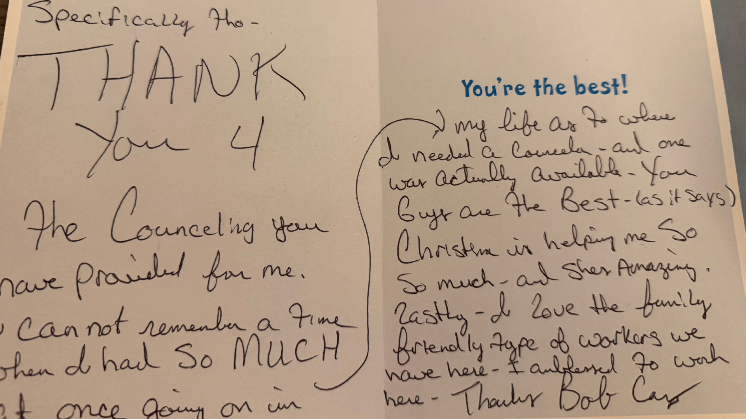

Slide 9
Upper Cumberland Regional Action Plan:
Empower 2.0
PDI Fellows, Zone 4: Stefanie Byrd, Samantha Cross, Adam Poe, Denny Wayne Robinson, Megan Spurgeon, Zach Stephens & Lisa Uhrik

